Slide 1
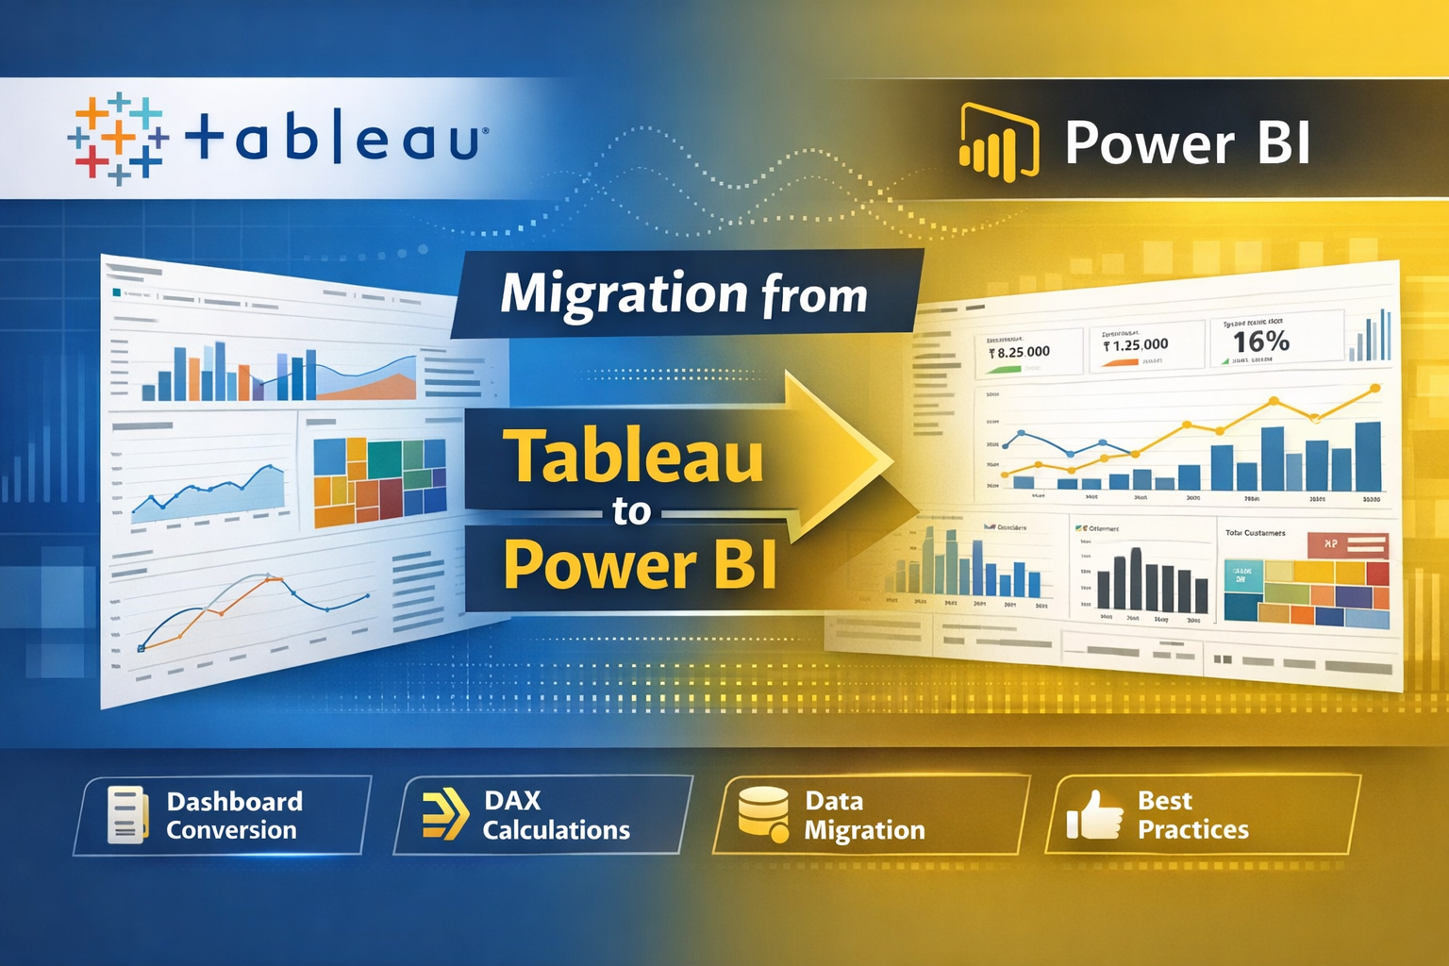
Harmeet Singh Sehra

Slide 2
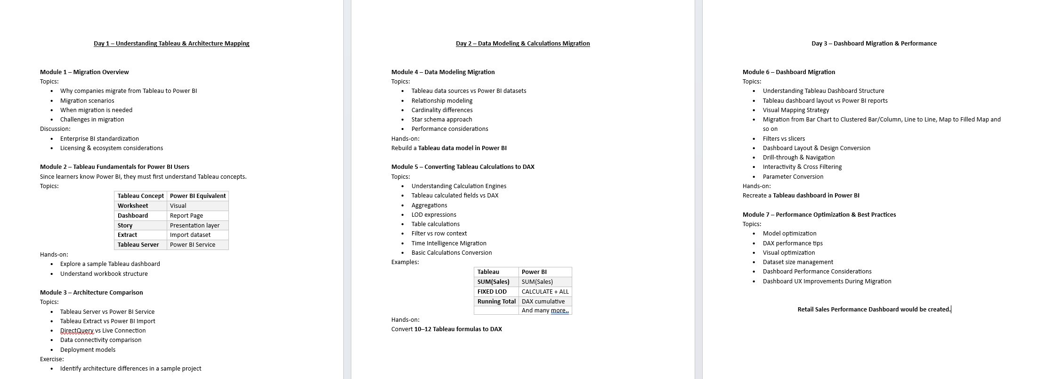
Table of Content

Slide 3
Day 01’s Agenda
Module 1 – Migration Overview
Why companies migrate from Tableau to Power BI
Migration scenarios
When migration is needed
Challenges in migration
Discussion:
Enterprise BI standardization
Licensing & ecosystem considerations
Module 3 – Architecture Comparison
Topics:
Tableau Server vs Power BI Service
Tableau Extract vs Power BI Import
DirectQuery vs Live Connection
Data connectivity comparison
Deployment models
Module 2 – Tableau Fundamentals for Power BI Users
Since learners know Power BI, they must first understand Tableau concepts.
Topics:
Tableau Concept
Worksheet
Dashboard
Story
Extract
Tableau Server

Slide 4
Migration Overview

Slide 5
Module 1 – Migration Overview

Slide 6
Migration Overview
In recent years, many organizations are evaluating their Business Intelligence (BI) platforms to ensure better scalability, cost efficiency, and integration with modern data ecosystems.
Two of the most widely used BI platforms are:
Tableau
Power BI
While both are powerful visualization tools, organizations often decide to standardize on one platform, leading to migration initiatives.
This module introduces the concept, reasons, and challenges of migrating dashboards from Tableau to Power BI.
Migration does not simply mean exporting files, but involves rebuilding analytics solutions in the new platform.

Slide 7
What is BI Platform Migration?

Slide 8
Business Intelligence Migration
BI Migration refers to the process of:
Moving dashboards
Rebuilding reports
Migrating data models
Converting calculations
Recreating visualizations
from one BI platform to another.

Slide 9
Why Organizations Use BI Tools
BI tools help organizations:
• Analyze business data • Create interactive dashboards • Track KPIs • Monitor performance • Support decision-making

Slide 10
Why Companies Migrate from Tableau to Power BI
Organizations migrate for several strategic reasons.

Slide 11
1 Cost Optimization
Power BI licensing is often more cost-effective, especially for organizations already using Microsoft tools.
2 Microsoft Ecosystem Integration
Power BI integrates seamlessly with:
Excel
Azure
Microsoft 365
Teams
SharePoint
3 Unified Analytics Platform
Many enterprises prefer a single platform for data analytics and reporting.
4 Self-Service Analytics
Power BI enables broader adoption among business users.

Slide 12
Key Business Drivers for Migration
Common drivers behind migration initiatives include:
• Reducing BI licensing costs • Consolidating analytics platforms • Standardizing reporting tools across departments • Leveraging Microsoft cloud ecosystem • Improving collaboration and sharing • Better integration with enterprise data platforms

Slide 13
Migration Scenarios
Organizations typically follow different migration approaches.
Scenario 1 – Full Migration
Scenario 2 – Partial Migration
Scenario 3 – Gradual Migration

Slide 14
Scenario 1 – Full Migration
All dashboards and reports are migrated to Power BI.
Used when organizations standardize on a single BI platform.

Slide 15
Scenario 2 – Partial Migration
Only selected dashboards are migrated.
For example:
Operational dashboards → Power BI
Advanced analytics → Tableau

Slide 16
Scenario 3 – Gradual Migration
Migration happens in phases over several months.
Existing dashboards continue running while new ones are built in Power BI.

Slide 17
When Migration is Needed
Migration may become necessary when organizations experience:
Tool Consolidation
Multiple BI tools increase complexity.
Cost Management
Organizations want to reduce tool licensing costs.
Technology Alignment
Organizations align analytics with cloud strategy or Microsoft ecosystem.
Skill Availability
Power BI skills are widely available compared to specialized tools.

Slide 18
What Gets Migrated?

Slide 19
During migration projects, the following components must be addressed:
• Data sources • Data models • Calculated fields • Dashboard layouts • Visualizations • Filters and interactions • Scheduled refresh processes
Migration involves rebuilding analytics logic in the new platform.

Slide 20
Migration Process Overview
Typical migration workflow:
Inventory existing Tableau assets
Analyze data sources and calculations
Rebuild data model in Power BI
Convert calculations to DAX
Recreate dashboards
Validate results
Deploy reports
This process ensures data accuracy and functional equivalence.

Slide 21
Challenges in Migration

Slide 22
Migration projects involve several challenges.
Calculation Conversion
Tableau formulas must be rewritten in DAX.
Dashboard Redesign
Layouts and visual behaviors differ between tools.
Performance Optimization
Different data engines require model adjustments.
User Adoption
Users must adapt to a new interface and workflow.

Slide 23
Migration is Not a File Transfer
Important concept for learners:
Tableau files cannot be directly opened in Power BI.
Instead, migration involves:
Reconnecting to data sources
Recreating data models
Rebuilding dashboards
Therefore, migration is often treated as a re-engineering exercise rather than simple conversion.

Slide 24
Benefits After Migration
Organizations often gain:
• Reduced BI costs • Better integration with Microsoft tools • Improved collaboration • Centralized reporting environment • Scalable cloud analytics

Slide 25
Module 2 – Tableau Fundamentals for Power BI Users

Slide 26
Module 2 – Tableau Fundamentals for Power BI Users
Since learners know Power BI, they must first understand Tableau concepts.
Tableau Concept | Power BI Equivalent
Worksheet | Visual
Dashboard | Report Page
Story | Presentation layer
Extract | Import dataset
Tableau Server | Power BI Service

Slide 27
Understanding Tableau Architecture

Slide 28
Tableau organizes analytics content using a hierarchy of objects.
Basic structure:
Data Source → Worksheet → Dashboard → Story → Published to Server

Slide 29
• Data Source – Where data comes from • Worksheet – Individual visualization • Dashboard – Combination of visualizations • Story – Sequential narrative using dashboards • Tableau Server – Platform for sharing dashboards

Slide 30
Worksheet vs Visual

Slide 31
Tableau: Worksheet
A worksheet in Tableau is a single visualization workspace where users create charts.
Examples:
• Bar charts • Line charts • Maps • Scatter plots
Each worksheet typically represents one chart or analysis view.

Slide 32
Power BI Equivalent: Visual
In Power BI, a visual represents a single chart on a report canvas.
Examples:
• Column chart • Line chart • KPI card • Matrix

Slide 33
Dashboard vs Report Page

Slide 34
Tableau Dashboard
A dashboard combines multiple worksheets into a single interactive view.
Features:
• Multiple charts on one screen • Filters and interactions • Layout containers • Dashboard actions
Dashboards are typically used for executive summaries or business monitoring.

Slide 35
Power BI Equivalent: Report Page
In Power BI, dashboards are usually represented by report pages.
A report page contains:
• Multiple visuals • Slicers • Filters • Interactive elements

Slide 36
Story vs Presentation Layer

Slide 37
Tableau Story
A story in Tableau allows users to present insights step-by-step using a sequence of dashboards or worksheets.
Each step is called a Story Point.
Stories are used for:
• Business presentations • Data storytelling • Guided analytics

Slide 38
Power BI Equivalent
Power BI does not have a direct “Story” feature.
However similar outcomes can be achieved using:
• Report page navigation • Bookmarks • Buttons • Presentation mode

Slide 39
Extract vs Import Dataset

Slide 40
Tableau Extract
Tableau can store a snapshot of data locally using an Extract.
Features:
• Stored in .hyper format • Faster query performance • Reduces dependency on live data source • Used for offline analysis
Extracts are widely used for performance optimization.

Slide 41
Power BI Equivalent – Import Mode
In Power BI, Import mode loads data into the VertiPaq engine.
Features:
• Data stored in PBIX dataset • High-performance in-memory analytics • Supports advanced DAX calculations

Slide 42
Tableau Server vs Power BI Service

Slide 43
Tableau Server
Tableau Server is the platform used to publish and share dashboards within an organization.
Capabilities:
• Dashboard sharing • User access control • Data refresh scheduling • Collaboration
Organizations can deploy Tableau Server on-premise or in cloud environments.

Slide 44
Power BI Equivalent – Power BI Service
Power BI Service is the cloud platform for sharing reports and dashboards.
Capabilities:
• Report publishing • Workspace collaboration • Scheduled refresh • Dashboard sharing

Slide 45
Why This Mapping Matters for Migration

Slide 46
When migrating dashboards:
• Worksheets must be recreated as visuals • Dashboards must be redesigned as report pages • Extract-based datasets must be rebuilt as Power BI datasets • Stories may need bookmark-based navigation
Understanding these equivalences makes
migration
faster and more structured.

Slide 47
Tableau Interface Explained for Power BI Users
When Power BI users first open Tableau, the interface may look different.
However, the core purpose remains the same:
• Connect to data • Build visualizations • Create dashboards • Share insights

Slide 48
Main Components of Tableau Interface

Slide 49
The Tableau workspace is divided into several important areas:
Data Pane
Shelves (Rows, Columns, Filters)
Marks Card
Visualization Canvas
Show Me Panel
Dashboard Layout Panel

Slide 50
Data Pane
The Data Pane displays all available fields in the dataset.
Fields are categorized into:
• Dimensions • Measures
Dimensions represent categorical data such as:
Region
Customer Name
Category
Measures represent numerical data such as:
Sales
Profit
Quantity

Slide 51
Power BI Equivalent
Power BI also organizes fields inside the Fields pane, where users select columns and measures for visuals.

Slide 52
Rows and Columns Shelves
Rows Shelf
The Rows shelf determines what appears on the vertical axis of the chart.
Columns Shelf
The Columns shelf determines what appears on the horizontal axis.
Example:
Columns → Order Date Rows → SUM(Sales)
This produces a line chart showing sales trend over time.

Slide 53
Power BI Equivalent
In Power BI, similar behavior is controlled using:
• Axis • Legend • Values

Slide 54
Marks Card
The Marks Card controls how the visualization looks.
Options available in Marks card include:
• Color • Size • Label • Detail • Tooltip
Example:
Sales → Color Region → Detail
This helps create more informative visualizations.

Slide 55
Power BI Equivalent
Power BI uses the Format pane and field wells to control visual appearance.

Slide 56
Filters Shelf
Filters allow users to restrict data shown in a visualization.
Examples:
• Filter by Region • Filter by Category • Filter by Date range
Filters can be applied at:
• Worksheet level • Dashboard level

Slide 57
Power BI Equivalent
Power BI offers multiple filtering options:
• Visual filters • Page filters • Report filters • Slicers

Slide 58
Show Me Panel
The Show Me panel suggests different chart types based on selected data fields.
Examples of charts suggested:
• Bar chart • Line chart • Map • Scatter plot • Treemap

Slide 59
Power BI Equivalent
Power BI uses the Visualizations pane, where users manually select chart types.

Slide 60
Visualization Canvas
The canvas is the central area where visualizations are displayed.
Users drag fields from the Data Pane and place them on:
• Rows • Columns • Marks
Tableau automatically generates a chart based on field combinations.

Slide 61
Power BI Equivalent
In Power BI, visuals are created on the Report Canvas.

Slide 62
Dashboard Layout Panel
When creating dashboards, Tableau provides a layout panel where users can arrange worksheets.
Options include:
• Horizontal containers • Vertical containers • Floating objects
This helps design structured dashboards.

Slide 63
Power BI Equivalent
Power BI allows arranging visuals directly on the report page canvas.

Slide 66
Module 3 – Architecture Comparison
Topics:
Tableau Server vs Power BI Service
Tableau Extract vs Power BI Import
DirectQuery vs Live Connection
Data connectivity comparison
Deployment models

Slide 67
Understanding BI Platform Architecture

Slide 68
When organizations migrate from Tableau to Power BI, it is important to understand how both platforms handle:
• Data storage • Data processing (Calculated Fields) VizQL Engine of Tableau is as same as DAX of Power BI • Dashboard publishing • User access • Deployment models

Slide 69
High-Level Architecture Overview
Both platforms follow a similar analytics workflow:
Data Sources → Data Processing → Visualization → Sharing & Collaboration

Slide 70
Tableau architecture typically includes:
• Tableau Desktop • Tableau Server / Tableau Online • Data extracts
Power BI architecture includes:
• Power BI Desktop • Power BI Service • Power BI Gateway • Power BI datasets

Slide 71
Tableau Server vs Power BI Service

Slide 72
Tableau Server
Tableau Server is the platform used for publishing and sharing dashboards within an organization.
Key capabilities:
• Centralized dashboard hosting • User authentication and access control • Dashboard sharing across teams • Data refresh scheduling • Collaboration and comments
Tableau Server can be deployed:
• On-premise • Cloud infrastructure

Slide 73
Power BI Service
Power BI Service is the cloud-based platform for publishing and sharing reports and dashboards.
Key capabilities:
• Report and dashboard publishing • Workspace collaboration • Scheduled dataset refresh • Integration with Microsoft ecosystem • Sharing reports with internal teams

Slide 74
Tableau Extract vs Power BI Import

Slide 75
Tableau Extract
A Tableau Extract is a local snapshot of data stored in Tableau’s Hyper format.
Purpose:
• Improve performance • Reduce dependency on live databases • Enable offline analytics • Support faster dashboard loading
Extracts store a compressed version of the dataset.

Slide 76
Power BI Import Mode
Power BI Import mode loads data into the VertiPaq in-memory engine.
Benefits:
• High-performance queries • Fast visual rendering • Advanced DAX calculations • Efficient compression

Slide 77
Live Connection vs DirectQuery

Slide 78
Tableau Live Connection
A live connection allows Tableau dashboards to query the database directly in real time.
Characteristics:
• No local data storage • Always reflects latest data • Performance depends on source database
Common live data sources:
• SQL Server • Oracle • Snowflake • BigQuery

Slide 79
Power BI DirectQuery
DirectQuery allows Power BI to query the data source dynamically instead of importing data.
Characteristics:
• Real-time data access • Queries executed on the source system • Limited modeling features compared to Import mode

Slide 80
Data Connectivity Comparison

Slide 81
Both tools support connectivity with multiple data sources.
Common supported sources include:
• SQL databases • Cloud data warehouses • Excel files • CSV datasets • APIs and web services

Slide 82
Power BI Strength
Power BI has strong integration with Microsoft ecosystem:
• Azure SQL • Azure Synapse • SharePoint • OneDrive • Microsoft Fabric

Slide 83
Data Processing Engines
Tableau Data Engine
Tableau uses the Hyper engine for processing extracts.
Features:
• High-speed columnar database • Optimized for analytics workloads • Efficient compression
Power BI Data Engine
Power BI uses the VertiPaq engine.
Features:
• In-memory analytics engine • Columnar storage • High compression rates • Fast query execution

Slide 84
Deployment Models

Slide 85
Tableau Deployment
• Tableau Desktop (development) • Tableau Server (on-premise deployment) • Tableau Online (cloud deployment)
Power BI Deployment
• Power BI Desktop (development) • Power BI Service (cloud platform) • Power BI Report Server (on-premise option)

Slide 86
Component | Tableau | Power BI
Development Tool | Tableau Desktop | Power BI Desktop
Publishing Platform | Tableau Server | Power BI Service
Local Data Storage | Extract (.hyper) | Import Dataset
Live Data Access | Live Connection | DirectQuery
Data Engine | Hyper | VertiPaq
Cloud Platform | Tableau Online | Power BI Service
On-Premise Option | Tableau Server | Power BI Report Server

